Slide 1

Basic Details of the Team and Problem Statement
Ministry/Organization Name/Student Innovation: Govt of Rajasthan
PS Code:TK1050
Problem Statement Title:To create systems that alleviate waiting in line - at doctors, at shops, at bus stops
Team Name:Cyber Phoenixes
Team Leader Name:Sakshi Naik
Institute Code (AISHE): C-33770
Institute Name: Anjuman-I-Islam's M. H. Saboo Siddik College of Engineering
Theme Name:

Slide 2
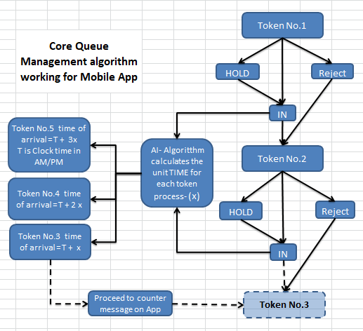
Idea/Approach Details
Idea or Solution
We will be adopting digitalization approach to develop a generic mobile app called “SmartQ” to generate and manage queues.
The app helps to generate queue quickly and helps people to take token nos either automatically or based on queue generator conditions. Once the queue starts, the AI enabled algorithm automatically assigns the arrival time for first few members of the queue with least waiting time.
Convenient medium for users
Estimate Time of Arrival mode
Realtime notification updates for calling queue members.
Supports Feature Phone
Add process flow chart or simulated image of prototype or any relevant image related to your idea
Technology stack :
Front End – Android Studio
Back End - AWS, Message91 api, Node Js
Mysql Database on AWS
Server: AWS, Firebase

Slide 3
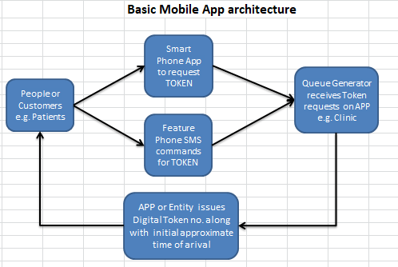
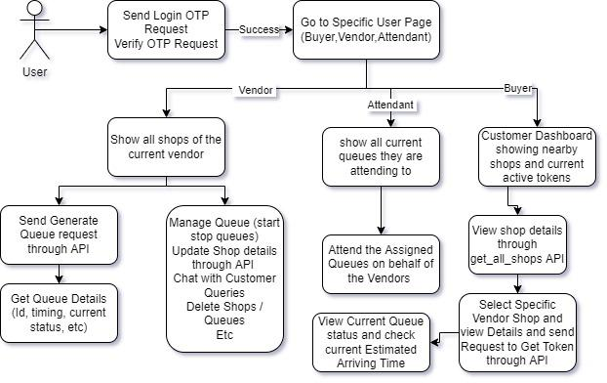
Idea/Approach Details
General Use cases
Describe your Use Cases here
Describe your Dependencies / Show stopper here
Feature phones can access only normal queue
The Vendor, Attendants and Buyers need to be equipped with smart phones and internet.
Currently developed only for Android Devices.
Fake Vendors / Vendors uploading wrong Information

Slide 4
Team Member Details
Team Leader Name: Sakshi Naik
Branch : BE Stream : EXTC Year : III
Team Member 1 Name: Wasim Jasani
Branch::BE Stream : IT Year : II
Team Member 2 Name: Burhanuddin Hariyanawala
Branch:BE Stream : CSE(AI-ML) Year : II
Team Member 3 Name: Mohd Mahdi Allarakhia
Branch :BE Stream : IT Year : II
Team Member 4 Name: Pratik Rane
Branch : BE Stream :CE Year : II
Team Member 5 Name: Umer Khan
Branch : BE Stream :CSE(AI-ML) Year : II
Team Mentor 1 Name: Dr. Irfan Landge
Category :Academic Expertise : AI/ML Domain Experience : 12

